Slide 1
Quant
2024-2025
Hack Night 2 9/19/24

Slide 2
Agenda
https://tinyurl.com/3zy4jrvn ← fill this out if you haven’t!
Introductions & Ice breakers
Brain teaser
Probability / Dynamic Programming
Sharpe Ratio
Dark Pools
Projects

Slide 3
Probability

Slide 4
Dynamic Programming

Slide 5
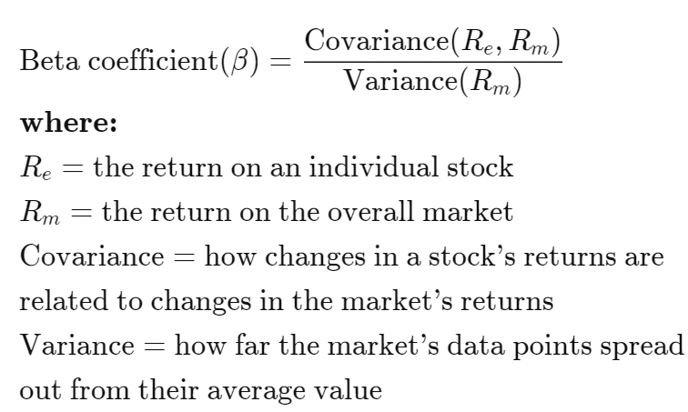
Beta
Investopedia

Slide 6
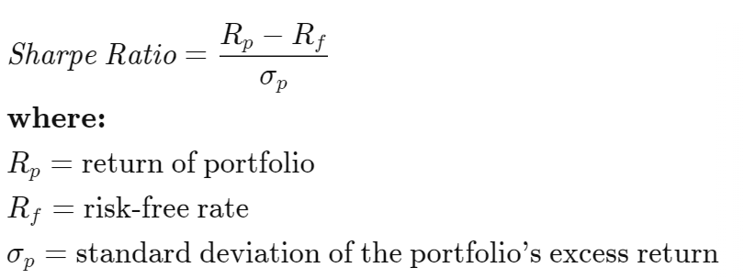
Sharpe Ratio
Investopedia

Slide 7
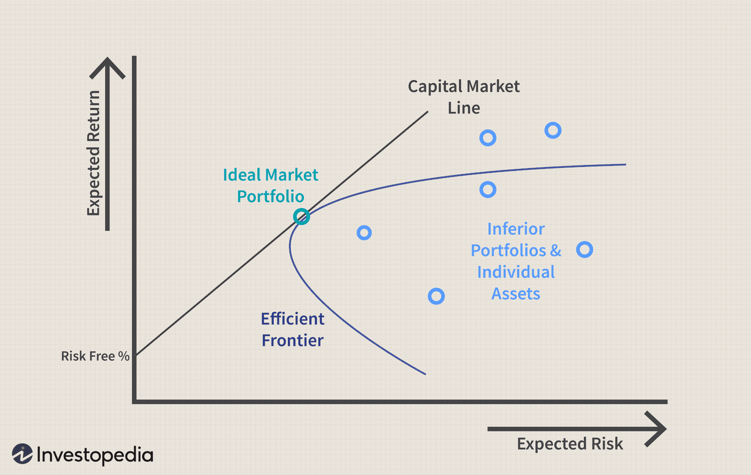
Capital Asset Pricing Model

Slide 8
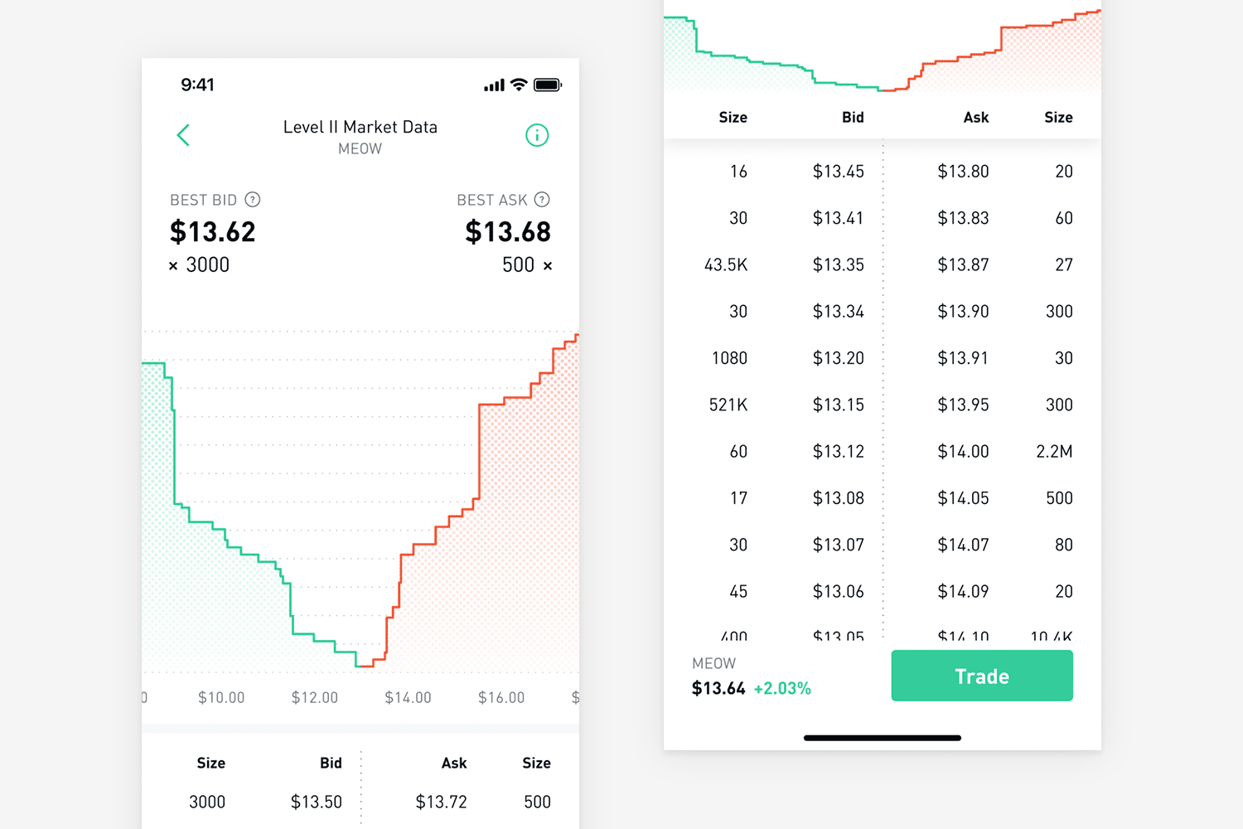
Order Book
Price | Buy | Sell
$102 |  | 100
$101 |  | 50
$100
$99 | 100
$98 | 200

Slide 9

Dark Pools
NYSE
CBOE
NASDAQ
Morgan Stanley MS Pool
Goldman Sachs Sigma X

Slide 10
Projects

Slide 11
Stock Market Simulator
Take in orders in the format <ticker> <buy_or_sell> <quantity> <order_type> <price> <time>
Output the transactions <ticker> <quantity> <price> <time>
Language: Any
Advanced Options:
Print out order book n prices deep
Dark Pools & Orders!
Able to take in complex order types
Anything else you can think of!

Slide 12
Figgie/Poker Game Theory
Poker Theory-esque strategy
Calculate best strategies based on your information and your opponent’s perceived information
Advanced Options:
Greater than 2 players
Anything else!

Slide 13
Implement Trading Strategy
Possible continuation from last semester’s project.
Possible Trading Strategies to Implement:
Pairs Trading
Relative Strength Index (RSI)
Anything else!
Advanced Options:
Use Sharpe ratio to calculate optimal bundle of goods
(Will talk about sharpe ratio more next week)

Slide 14
Next Week
Options
and more!

